Slide 1
Veterinary Appoinment System
Course Name: Advanced Databse Systems under the guidance of
Prof. Khomsun Singhirunnusorn
Group-3:
ROHINI MUNIGANTI - 700762192
RISHIKA REDDY GANGAPURAM - 700765898
PADMINI BOLEM - 700763620
RAJA RAJESWARI REGALLA - 700776644

Slide 2
PROJECT DESCRIPTION
Centralized platform for managing appointments, treatments, and payments
Role-based access for pet owners, veterinarians, and administrators
Online appointment booking with real-time vet availability
Complete medical history tracking including vaccinations, treatments, and allergies
Support for uploading documents such as certificates and insurance records
Automated reminders for upcoming appointments and due treatments
Secure payment management with digital receipt generation
Strong data security and user authentication
Administrative dashboards with reports on appointments and medicine usage
Enhances pet care quality and improves clinic efficiency

Slide 3
DATABASE DESCRIPTION
1. Customers
Stores pet owner profiles including contact info and account status.
Serves as parent collection for pets, appointments, and payments.
2. Vets
Maintains veterinarian profiles with specialization and availability status.
Enables vet-specific scheduling and record access.
3. Admins
Contains administrative users with defined roles (admin/superadmin).
Responsible for system-wide management and approvals.
4. Pets
Holds pet details like species, breed, age, and medical notes.
Linked to both customer and pet type.

Slide 4
5. Pet types
Classifies pets by type and category (e.g., Domestic, Exotic).
Facilitates accurate filtering and clinic-wide reporting.
6. Appointments
Tracks visits between customers and vets.
Includes reason, date, and status (scheduled, completed, cancelled).
7. Treatments
Logs diagnosis, treatment notes, prescriptions, and follow-up needs.
Ensures consistent medical tracking for pets.
8. Payments
Manages financial records for appointments.
Includes payment method, receipt URL, and status (paid, refunded, etc.)

Slide 5
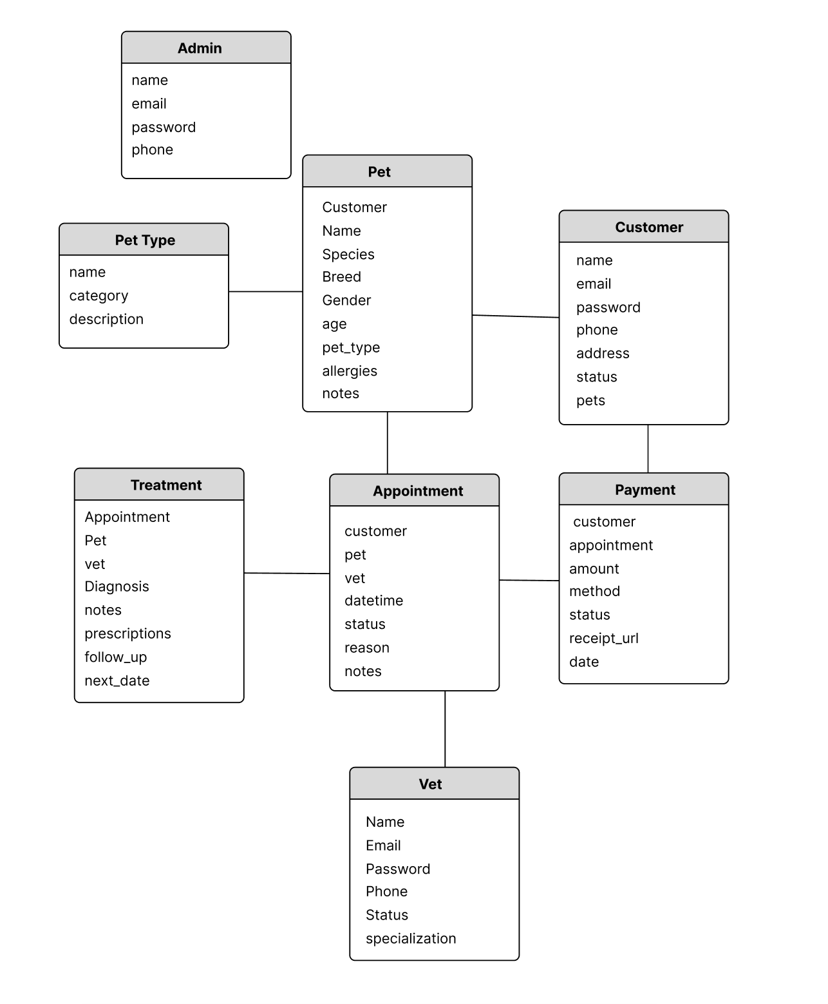
ER DIAGRAM:

Slide 6
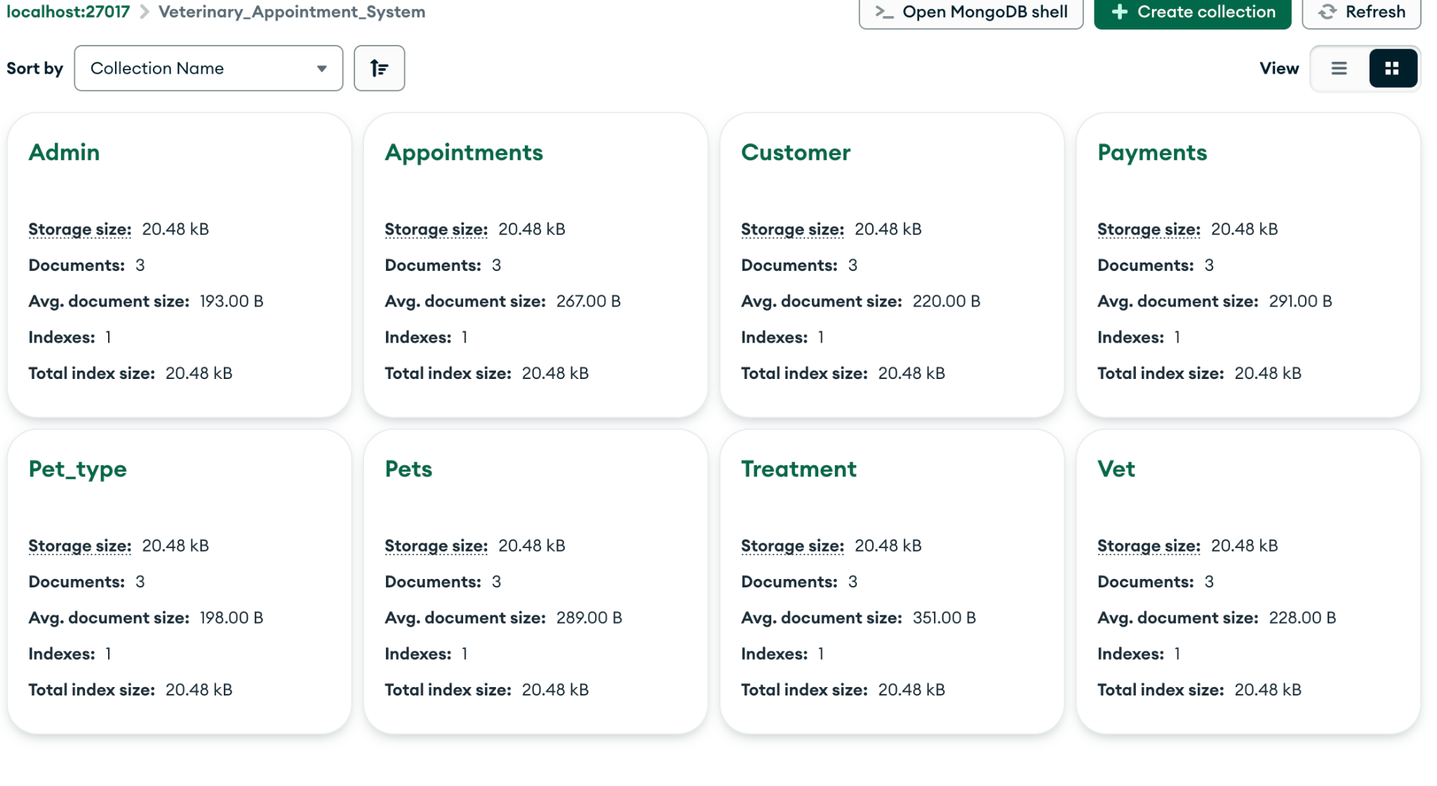
COLLECTIONS:

Slide 7
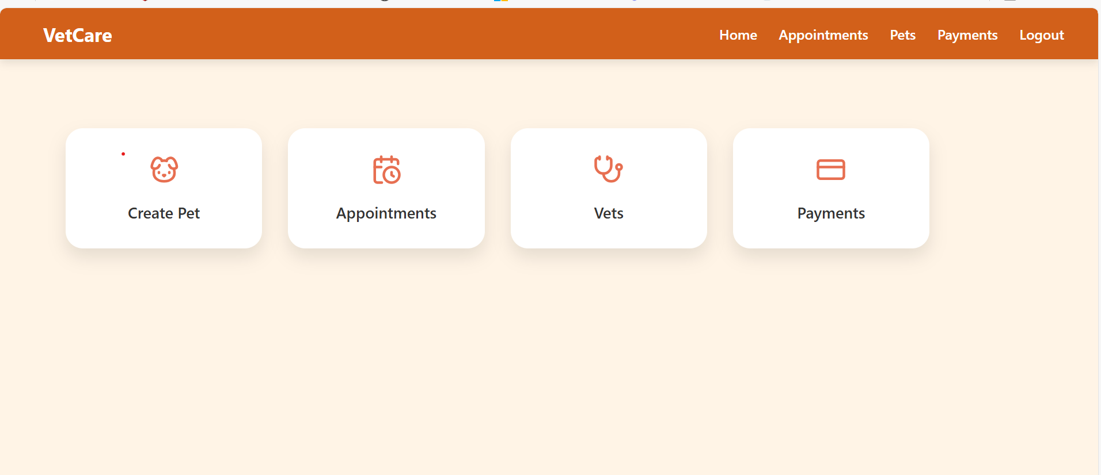
Admin Operations Overview
Create Pet: Add new pets with categories i.e, breed.
Appointments: Schedule, modify, or cancel appointments; assign vets.
Vets: Manage vet profiles, specializations, and availability.
Payments: View payment history, track status, and access receipts.

Slide 8
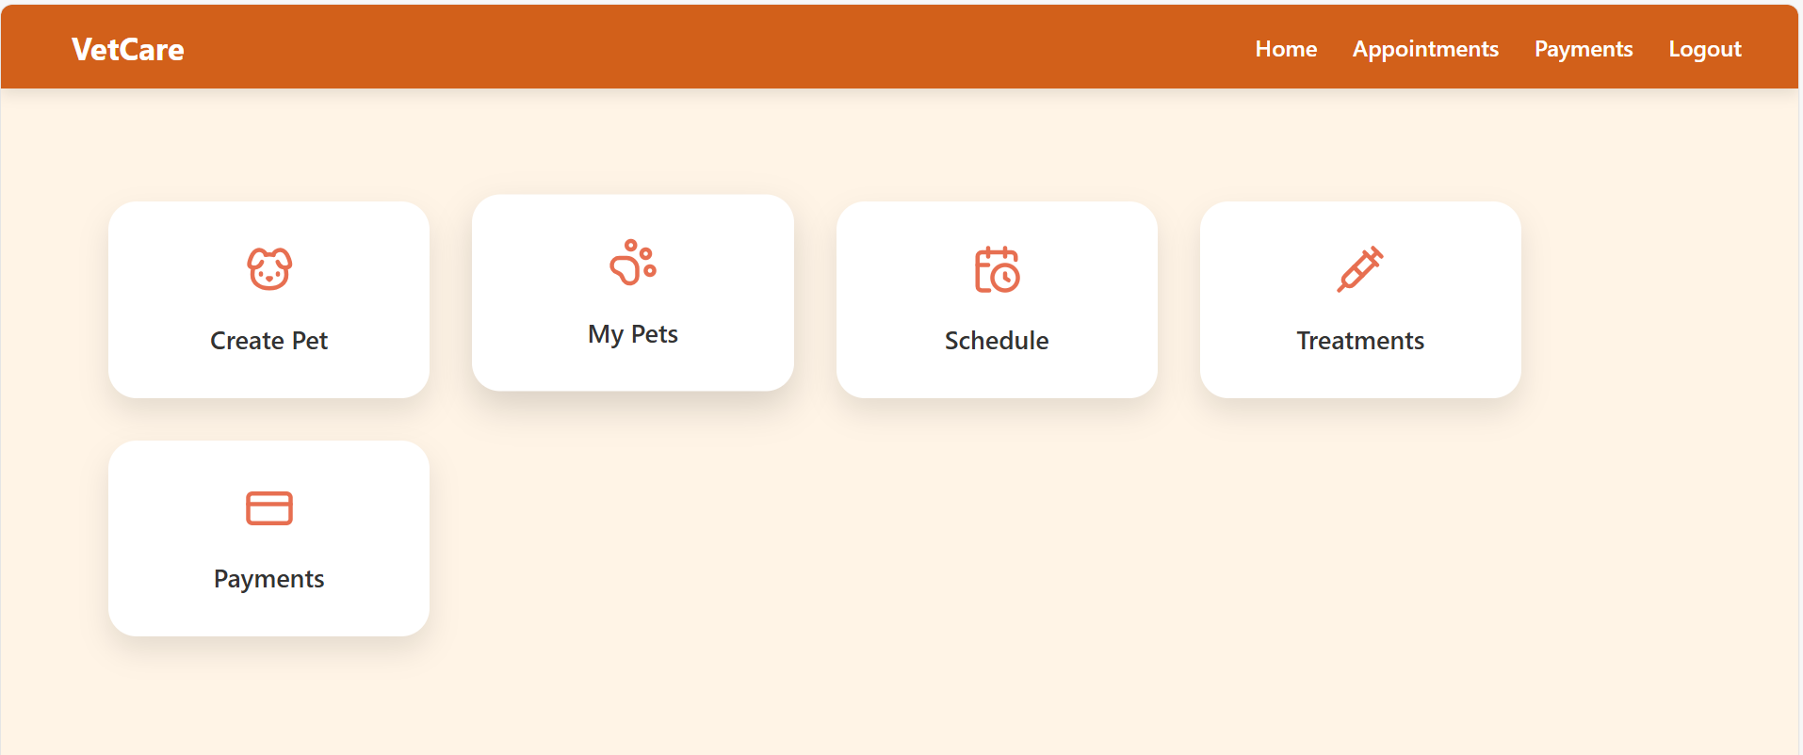
Customer Operations Overview
Create Pet: Register new pets with details like species, breed, age, and medical info.
My Pets: View, manage, and update profiles for all registered pets.
Schedule: Book appointments with available vets by selecting date and time.
Treatments: Access medical history including diagnoses, prescriptions, and care notes.
Payments: View past transactions, download receipts, and track service costs.

Slide 9
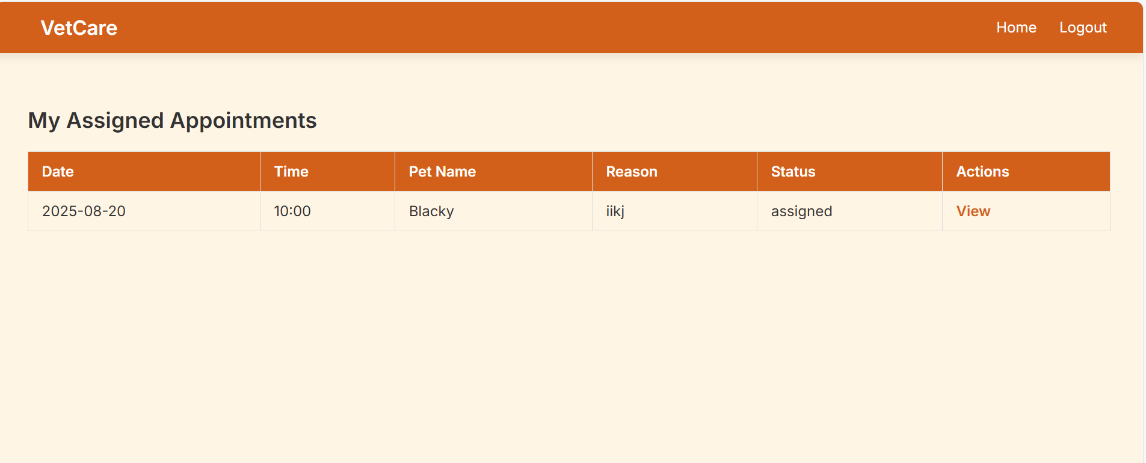
Veterinarian Operations Overview
View Appointments: Access daily schedule with pet and owner details.
Manage Treatments: Record diagnosis, add treatment notes, and prescribe medications.
Access Pet Records: Review medical history, allergies, and previous visits for informed care.
Update Follow-Ups: Schedule or recommend future visits and care plans.

Slide 10
CONCLUSION
The Veterinary Appointment System effectively bridges the gap between pet owners, veterinarians, and clinic administrators through a centralized, user-friendly platform. By streamlining appointment scheduling, medical recordkeeping, and administrative tasks, it enhances operational efficiency and ensures high-quality, continuous care for a wide range of animals. The system’s adaptability, automation, and data-driven insights make it a valuable tool for modern veterinary practices aiming to deliver more organized, responsive, and compassionate care.

